Slide 1


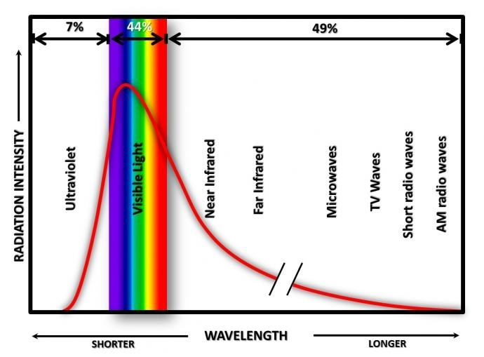
Adapting NASA’s MAPSS Databases to Desktop Computing Southwestern Oklahoma State University
Hayden Webb | Devin Smoot | Department of Computer Science
Abstract
Work Plan
Wavelength Visualization
The capability of desktop computers has increased greatly over the past several decades, even outpacing some of the first supercomputers. A standard Intel i7-4790 processor can run at 90 Gigaflops. This means it can complete almost ten to the tenth operations per second. Hence, in a time when you can buy a new 8th generation intel processor for a few hundred dollars, an older 4th generation intel processor is more powerful than the most powerful computer in the world in 1993.
In this research, we examine code developed for a NASA supercomputer and run it on a standard personal computer. Our results suggest that for simple tasks, such as pulling down information from the servers, the software is capable of running on a standard desktop. This demonstrates that when NASA produced code is adapted to a modern desktop computer, the computer can process the given information.
In summary, we can show that modern desktop computers not only have more processing power than some of the first supercomputers, but can easily handle applications attended for processing large sums of data. From a larger perspective, this shows how computers evolved to the point where what is considered an outdated processors is still leagues above what was first produced. This material is based upon work supported by the National Aeronautics and Space Administration under Grant No. NNX15AK02H NASA Oklahoma Space Grant Consortium.
The original work plan was to convert the MAPSS database to a desktop computer application. This project is building on the work done by past SWOSU students. These previous students had already managed to get several of the sensor’s data working on the desktop computer. This complete work had to be gathered and updated to fit the current version of Python. A major part of the project was going to be setting up the appropriate libraries for each sensor. When this was discovered we decided to change software to WRF before later returning to MAPSS.
WRF
This diagram demonstrates the shift in wavelength the CMB will experience throughout its life span.
The Weather Research and Forecasting model (WRF) was created by the National Center for Atmospheric Research (NCAR).
The software works to model a large range of meteorological events.
It functions as a forecasting application and supports atmospheric research.
The software was has several extenstion to allow the study and model of the water cycle, wild fire, air chemicals, and more.
Conclusion
The primary goal of the literature review was to establish a need for continuing research on the CMB.
A common theme among earlier works appears to be compounding information and verifying others works.
More recent CMB research appears to have become more specialized.
Modern papers are more likely to repeat each other rather than working in connection to affirm and expand on each other.
There also appears to be a lack of a standard for mapping that has been produced as of late.
More research is warranted in this field in order to reestablish a common modern standard.
Future projects should tend toward reaffirming information rather than exploring new avenues.
After the creation of a modern standard CMB research will potentially be more unified and driven.
What is MAPSS?
Work Developments
A recent example of CMB research is found in Yacine Ali-Haïmoud and Marc Kamionkowski (2017). Their paper seeks to discuss the relationship between the CMB and primordial black holes (PBHs). The paper was founded on that current theory that PBHs might comprise some or all of the universe’s dark matter. The paper looks at the effects of PBHs on the CMB temperature and polarization power spectra. Yacine and Marc attempt to accomplish this by computing the luminosity of PBHs while accounting for the drag and cooling caused by CMB photons. They also estimate the Schwarzchild radius and velocity of the primordial black holes by the surrounding gas. Yacine and Marc revised existing CMB limits to include the abundance of PHBs and noted that “We showed that CMB-anisotropy measurements by the Planck satellite exclude PBHs as the dominant component of dark matter…”. Primordial black holes are a rather recent develop in study of the CMB and will require more research as the field continues.
Multi-sensor Aerosol Products Sampling System (MAPSS)
It is used to create a consensus between different aerosol sensors.
It has access to a collection of both ground and space based sensors.
The sensors include AERONET, MODIS, MISR, OMI, POLDER, CALIOP, and SeaWiFS.
MAPSS is used to confirm and compare data across the different sensors.
MAPSS is open to the public and thus allows scientist and researchers across the world to use the collected data.
Works Cited
https://ntrs.nasa.gov/archive/nasa/casi.ntrs.nasa.gov/20120003903.pdf
https://disc.gsfc.nasa.gov/information/glossary?title=MAPSS%20(A%20Multi-sensor%20Aerosol%20Products%20Sampling%20System)

